Slide 1

AgriTech: AI-Powered Smart Farming
School of Computer Science and Engineering
Department of Computer Science and Engineering
Submitted By: Ada Khan Manas Srivastava
2427030691/2427030707
Supervised By: Dr. Jeyakrishnan V

Slide 2
Outline
Introduction
Literature Review
Problem Statement
Proposed Solution
Objectives
Results

Slide 3
Introduction
The Importance of Agriculture & Current Challenges
Agriculture in India - Backbone of India’s economy — contributes about 18% to India’s GDP and employs over 40% of the population, playing a key role in food security and rural development.
Current Challenges Faced by Farmers - Farmers face issues like crop diseases, erratic weather, and low access to technology, leading to reduced yields and income.
Need for Technological Intervention - AI-based solutions can help farmers make data-driven decisions, detect diseases early, and improve productivity and profits.

Slide 4
Role of AI and AgriTech in Model Farming
AgriTech - Agricultural Technology refers to the use of AI, ML, IoT, drones, and data analytics to enhance agricultural productivity and efficiency.
Role of Artificial Intelligence - Uses computer vision and drone imagery to detect crop diseases and identify crop types. Machine learning predicts yields, weather, and market demand while recommending irrigation, fertilizer, and planting schedules.
Why AI-Driven AgriTech Matters - It boosts yield and income, reduces middlemen, promotes sustainable farming, and enables real-time, data-driven decisions.

Slide 5
Literature Review
AI & Computer Vision in Modern Agriculture
Deep learning models (CNN, ResNet) improve crop disease detection by 40–60% (2018–2024).
Drone and satellite imaging enable real-time crop health monitoring and yield prediction.
AI-powered image analysis can identify 25+ diseases in rice, wheat, and cotton.
Farmers using AI report up to 30% reduction in pesticide use and improved sustainability.
Early-stage infection detection allows timely intervention, increasing yield.
Example: Microsoft AI for Earth helped Andhra Pradesh farmers predict optimal sowing dates, boosting yields by 10–15%.

Slide 6
AI in Market Analysis and Crop Planning
Research (2019–2023) focused on combining machine learning with market forecasting to guide crop selection based on demand, weather, and soil.
CropIn Technology and IBM Watson provide AI-driven, market-aware insights to farmers in India.
Data-driven systems reduce dependence on intermediaries by predicting fair prices and profitable crops.
AI advisory systems can boost farmers’ income by 20–25% through optimized decisions and resource use.
Example: Agmarknet provides crop price data, enabling AI systems to recommend profitable selling strategies.

Slide 7
Problem Statement
Farmers face crop diseases, low yield prediction and lack of market insights. AI-driven solutions can detect diseases, monitor crops and suggest profitable planting strategies.

Slide 8
Objectives
Detect crop diseases early using AI and computer vision.
Identify and monitor crops through drone or image-based analysis.
Predict market demand and recommend profitable crops and selling strategies.
Empower farmers with data-driven insights to increase yield and income.

Slide 9
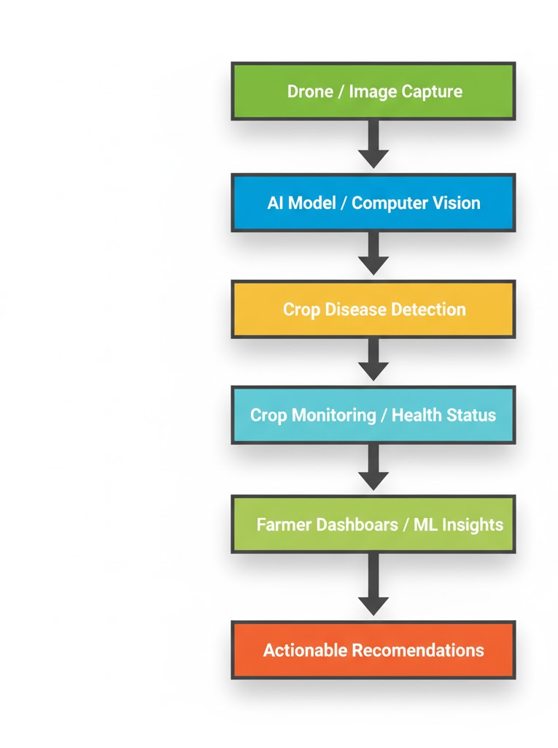
Proposed Methodology
AI-driven AgriTech system for crop disease detection, monitoring, and market-based recommendations to boost farmer yield and profit.
Steps to Provide Solution:
Data Collection: Capture crop images and field data using drones and sensors.
Crop Disease Detection: Analyze images with computer vision (CNNs) to detect diseases early.
Crop Monitoring: Identify crop types, growth stages, and health status using AI models.
Market Analysis: Collect regional market price and demand data; predict trends using ML models.
Crop Recommendation: Suggest which crops to grow, optimal quantity, and selling price based on health and market insights.
Farmer Dashboard / Alerts: Deliver actionable insights via a mobile app or dashboard, guiding farmers on farming and selling decisions.

Slide 10
AI-Based Crop Disease Detection Module
To achieve early disease detection, a Convolutional Neural Network (CNN)-based model will be developed using transfer learning techniques.
Key Approach:
Datasets such as PlantVillage and crop-specific leaf datasets will be used.
Images will undergo preprocessing (resizing, normalization, augmentation).
Pre-trained architectures such as MobileNet (for efficiency) or ResNet50 (for higher accuracy) will be fine-tuned.
The model will classify diseases and detect early infection patterns.
Output:
Predicted Disease Type
Severity Estimation
Suggested Preventive Action
This enables farmers to intervene early, reducing pesticide overuse and crop loss.

Slide 11
2. Market Forecasting and Price Prediction Module
To help farmers make profitable selling decisions, a machine learning-based time-series forecasting system will be developed.
Data Sources:
Agmarknet price datasets
Historical demand data
Seasonal and weather trends
Output:
Future Price Predictions
Demand Trend Forecast
Seasonal Price Fluctuation Analysis
This reduces uncertainty in selling strategies.

Slide 12
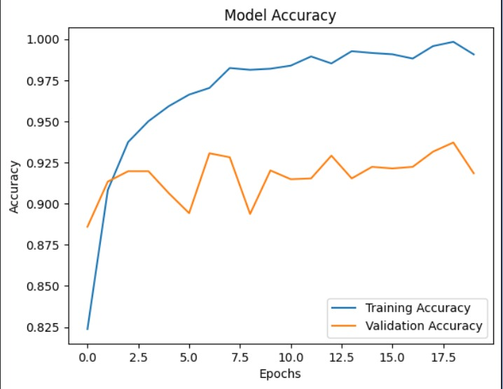
RESULT
Comparision of 3 different models with the same dataset
Pretrained MobileNetV2 Model
Training accuracy increases steadily and reaches ~99%.
Validation accuracy remains around 90–93%, indicating good performance on unseen data.
A gap between training and validation accuracy suggests mild overfitting.
Validation accuracy fluctuations indicate variation in dataset patterns.
Requires improvement for better generalization.

Slide 13
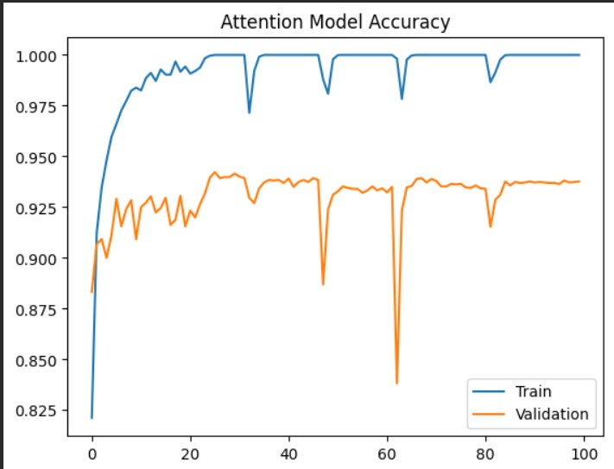
RESULT
2. Attention Model (ADF-Net idea)
Training accuracy reaches ~100%.
Validation accuracy improves to ~93–94%.
Attention helps focus on diseased regions.
Slight fluctuations due to data variation.
Minor overfitting still present.

Slide 14
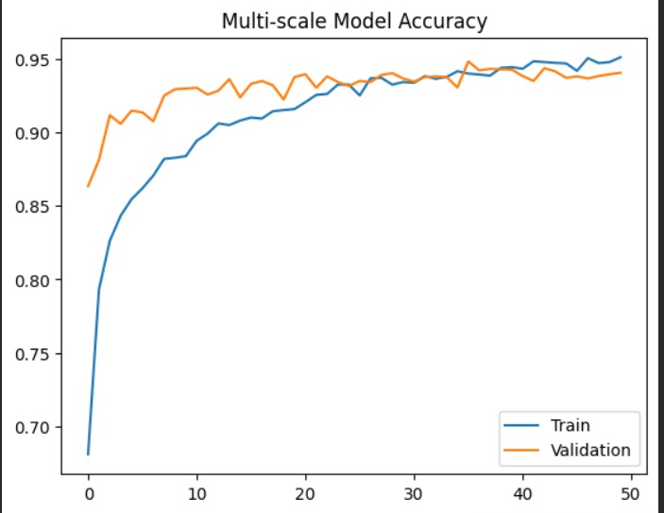
RESULT
3. Multi-scale Model (ADF-Net idea)
Fast learning in early epochs
High accuracy (~94–95%)
Low overfitting (train ≈ validation)
Stable performance after convergence
Captures both small & large disease patterns

Slide 15
References
Published research studies and reports (2018–2024) on AI and machine learning in agriculture, particularly on crop disease detection, yield prediction, and market forecasting.
Case studies and implementations by companies like Microsoft AI for Earth, CropIn Technology, and IBM Watson Decision Platform for Agriculture.
Government and public platforms, e.g., Agmarknet in India, which provides open crop price data.
General knowledge about AI applications in agritech—like the use of CNNs, ResNet, drones, and advisory systems—which is widely documented in scientific literature and news articles.

Slide 16
Thank You

